Slide 1
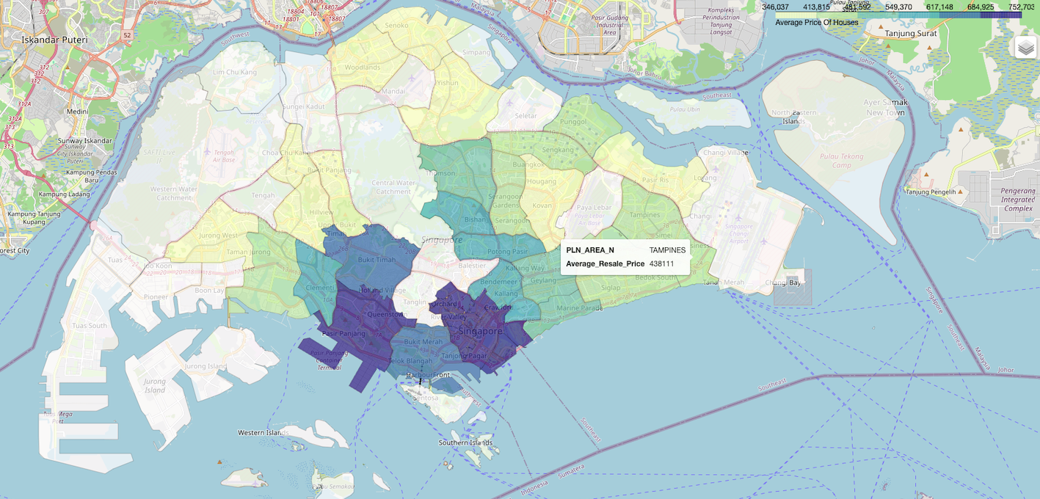
Question 1 (a) (i)
Note:
Mean was used as summary statistic on price for this study.
Average resale HDB price was aggregated based on planning area boundary.
Average resale HDB price shown in the choropleth map represents 4-room resale HDB for the year 2017.
Choropleth map was plotted using Folium.
2019 planning area boundary was used instead of the provided 2014 version because the 2014 geojson version does not have the correct latitude and latitude value. Hence, the 2014 boundary cannot be overlaid to Singapore map. This issue is resolved by using the 2019 version.

Slide 2
Question 1 (a) (ii)
From the choropleth map shown in the previous slide, the following observations can be drawn:
Resale HDB located within the central area and Queenstown area have the highest average resale price. Because of their ideal locations, which provide easy access to important services and effective transit, central area HDBs are pricey. Elevated property values are a result of limited land availability and high demand in these key places. HDB units in these regions are more expensive due to the ease and desirability of being centrally located. On the other hand, Queenstown is a developed town with a strategic location that offers a rich history, sociocultural relevance, and well-connected public transit. These all contribute to the high cost of resale HDB apartments in the Queenstown area.
Average resale HDB price increases as proximity to central area increases with average resale HDB price. Moving out from key districts results in lower HDB prices, mostly because there is more land available and less demand. There is usually less demand for houses in peripheral locations because they are farther from business zones and have fewer facilities. These places have more land available than core districts, which makes the market more competitive and drives down HDB prices.
Average resale HDB price is more expensive in mature estates (Clementi) compared to non-mature estates (Jurong West). Mature estate HDB prices are typically more expensive for a variety of reasons. Mature estates are very sought-after because of their well-established infrastructure, practical amenities, and close access to important facilities. The established open spaces, schools, healthcare services, and dependable public transportation that these mature communities typically offer add to the demand for housing in these locations. In mature estates, the scarcity of land for new developments adds to the value of real estate. When comparing mature estates to newer or less developed locations, the combination of these variables results in higher HDB prices.

Slide 3
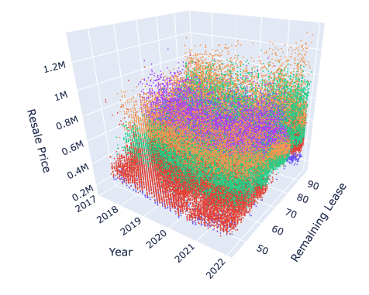
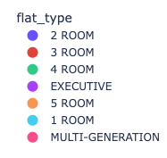
Question 1 (b) (i)
Note:
Resale HDB price for all flat type for year 2017 to 2022 was used.
3D scatterplot was plotted using Plotly.

Slide 4
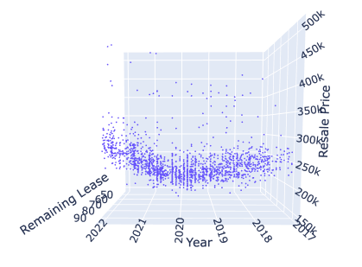
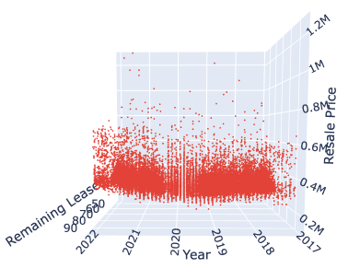
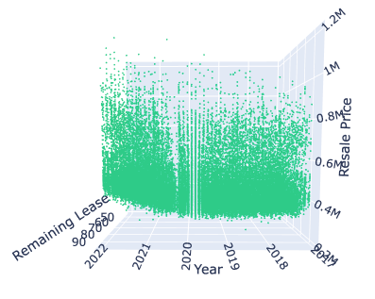
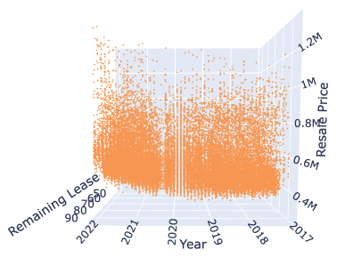
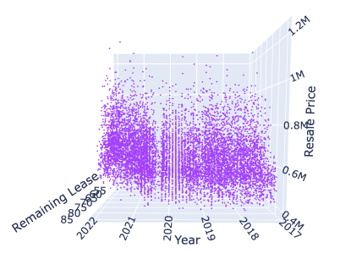
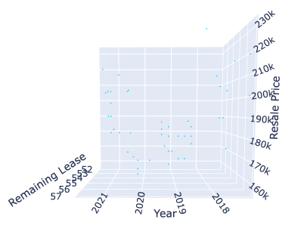
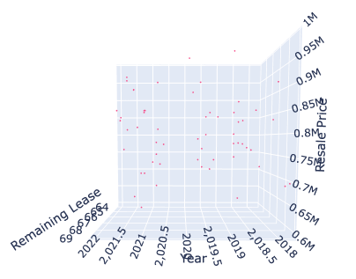
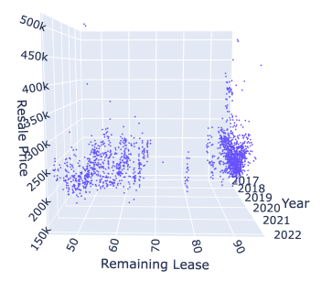
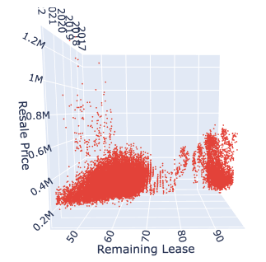
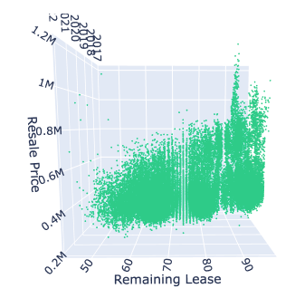
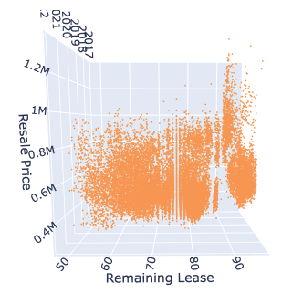
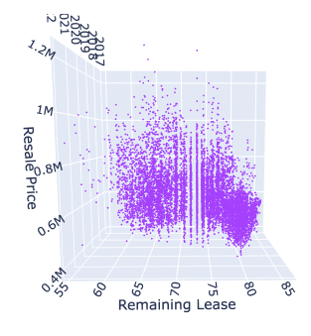
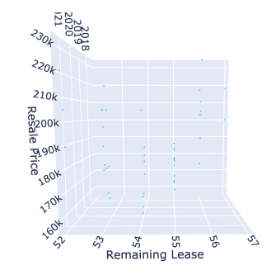
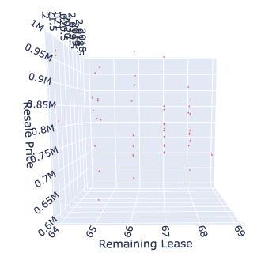
Question 1 (b) (ii)
2 Room
3 Room
4 Room
5 Room
Executive
1 Room
Multi-Generation
Average Resale HDB Price vs Year
Average Resale HDB Price vs Remaining Lease
Based on the 3D scatterplot, the following key observations can be drawn:
The average resale HDB prices rose from 2017 to 2022, especially in 2021-2022, possibly due to uncertainties around BTO projects during the COVID-19 pandemic. Buyers may have shifted towards resale flats due to delays in BTO projects, driving up demand and prices.
The average resale HDB prices decreases with diminishing lease duration can be explained by several factors. Older flats often demand more frequent repairs, making them less appealing to buyers. Moreover, there is a prevalent preference for newer properties among buyers, given their perceived better conditions and modern amenities. This inclination towards newer flats, coupled with the potential maintenance costs associated with older units, contributes to the inverse relationship between resale prices and the remaining lease duration.
Larger HDB units typically come with higher price tags, reflecting a positive correlation between unit size and market value. This relationship is influenced by factors such as increased living space and additional amenities. Buyers often value larger units for their spaciousness, contributing to the higher market prices associated with such properties.

Slide 5
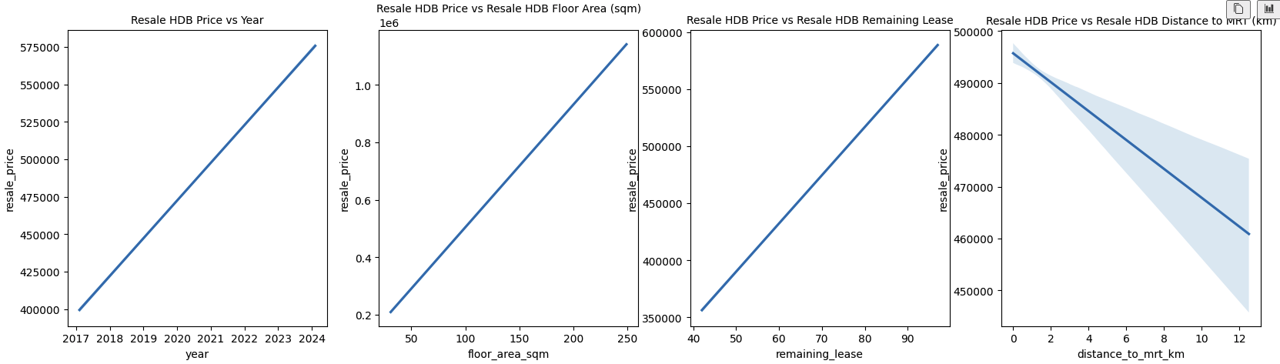
Question 2
Prior to constructing the hedonic regression model, a quick visualization was performed to determine the relationship between year, floor area, remaining lease and distance to MRT vs resale HDB price. Based on the visualization, the following preliminary findings can be drawn:
Resale HDB price is positively correlated with year i.e. resale HDB price increases along the years.
Resale HDB price is positively correlated with floor area.
Resale HDB price is positively correlated with remaining lease i.e. the higher the remaining lease, the higher the resale HDB price.
Resale HDB price is negatively correlated with distance to MRT i.e. the nearer the HDB to MRT, the higher the resale HDB price.

Slide 6
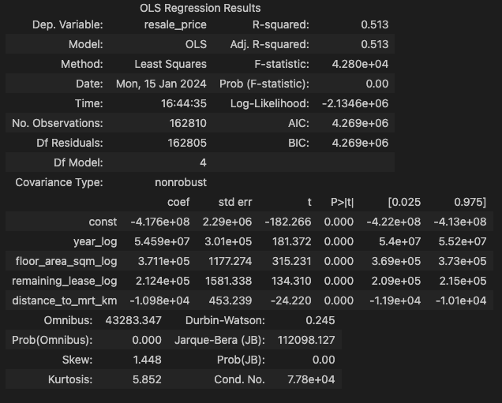
Question 2 - continued
Summary of Hedonic Regression analysis and key findings:
R-squared value is a measure of how well the independent variables explain the variability of the dependent variable. It indicates the proportion of the variance in the dependent variable that is predictable from the independent variables.
In our case, the R-squared value of 0.513 would mean our model explains 51.3% in resale HDB price variable.
P-value of all variables are < 5%, indicating that all the variables i.e. year, floor area, remaining lease and distance to MRT are statistically significant and has an impact on the resale HDB price.
As confirmed by visualization in the previous slide, the following conclusions can be drawn:
Resale HDB price is positively correlated with year, floor area and HDB remaining lease.
Resale HDB price is negatively correlated with HDB distance to MRT.
Resale HDB price is most affected by year variable as the coefficient for year is highest.

Slide 7
Question 3 (i)
Research Background
It's crucial to decide whether a buyer will opt for bank loan or HDB loan for several reasons stated as follow:
Risk Management for Financial Institutions - For financial institutions managing their loan portfolios, knowing the ratio of purchasers choosing HDB loans over bank loans is essential. It facilitates the evaluation of risk exposure, the customization of lending strategies, and the assurance of regulatory compliance.
Impact on Housing Affordability - Buyers' decisions on financing options impact housing affordability. They might prefer an HDB loan for lower interest rates or choose a bank loan for increased flexibility. Policymakers can gauge the accessibility of financing choices for a diverse buyer range by understanding these preferences.
Market Dynamics and Housing Demand - The decision between HDB and bank loans mirrors overall economic conditions, market trends, and buyer preferences. Observing the mix of loan types offers insights into market dynamics, benefiting real estate professionals, developers, and policymakers.
Government Housing Policies - Government housing policies and incentives can shape the allocation of HDB and bank loans. Evaluating buyer preferences aids policymakers in gauging policy effectiveness and exploring adjustments to promote housing affordability and economic stability.
Economic Indicator - The mix of HDB and bank loans acts as an economic gauge. Shifts in loan preferences may indicate changes in economic conditions, buyer sentiment, and financial market dynamics.
Market Research and Strategy - Property developers and investors benefit from knowing common loan preferences for market research and strategic decisions. This insight assists in customizing offerings to align with potential buyers' preferences and financial considerations.
This is a supervised binary classification machine learning problem whereby we must predict buyers will choose HDB loan or Bank loan.
We can simply classify buyers choosing HDB loan as the positive class and buyers choosing bank loan as the negative class.

Slide 8
Question 3 (i) - continued
Hypothesis
Below are some of the factors that will affect buyers’ decision in choosing between HDB and bank loan:
Buyers with lower cash balance will most likely choose HDB loan over bank loan.
Buyers with salary exceeding the HDB loan income ceiling will choose bank loan.
Buyers will most likely pick bank loan over HDB loan if interest rate of bank loan is lower than the interest rate of HDB loan.
If resale HDB prices are high, buyers will most likely choose HDB loans. This is a result of the substantial upfront cash related to bank loans.
Buyers’ citizenship status. Singapore citizens are more likely to opt for HDB loans.

Slide 9
Question 3 (ii)
Data Collection & Preparation
It is suggested that the following information be gathered and utilized to train the predictive model:
Data Required | Reasons to Include
Historical bank loan interest rate | To determine which loan type is lower in interest rate. Buyers typically choose loans with lower interest rate.
Buyers’ salary | Will determine if buyer exceeds the income ceiling eligibility for HDB loan.
Credit history of buyer | Will determine if buyer is cash tight. Buyers typically choose HDB loan if cash tight.
Any previous HDB loans taken | Buyer will not be eligible for HDB loan if previously taken 2 or more housing loans from HDB.
Buyers’ citizenship status | Will determine if buyer is eligible for HDB loan. Only citizens can apply for HDB loans.
HDB price and location | Centrally located HDBs are typically more expensive, driving up house down payment and enticing buyer to choose HDB loans.

Slide 10
Question 3 (iii)
Suggested Machine Learning Model
As the case study is a binary classification problem, the following classification predictive machine learning models are suggested:
Model | Reasons to Use | Pros | Cons
Logistic Regression | Suitable model as it is a classification algorithm used to find the probability of event success and failure. It is used when the dependent variable is binary in nature. It supports categorizing data into discrete classes by studying the relationship from a given set of labelled data. | Ease of implementation. Ease of interpretability due to probabilistic output. In comparison to more complicated models, it works well with small and linearly separable datasets and is less prone to overfitting. | It constructs linear boundaries. Model may not perform well if relationship is non-linear. It may not capture complex relationships in the data as effectively as more advanced algorithms like decision trees or neural networks. Logistic regression can be sensitive to outliers, which might affect the model's performance.
Random Forest | Popular ensemble algorithm used for classification tasks due to its high accuracy, robustness, versatility, and scalability. Random Forest reduces overfitting by averaging multiple decision trees and is less sensitive to noise and outliers in the data. It provides a measure of feature importance, which can be useful for feature selection and data interpretation. | Generally, provide high accuracy by combining the predictions of multiple decision trees. Less prone to overfitting and less sensitive to outliers compared to individual decision trees. The aggregation of predictions from multiple trees helps create a more robust model that generalizes well to unseen data. Can capture non-linear relationships between features and the target variable. They are capable of representing complex decision boundaries. | The ensemble structure and multiple trees make Random Forests more complex to interpret compared to individual decision trees. Training many trees in the forest can be computationally expensive and may require more resources. Random Forests may not perform well on imbalanced datasets without additional techniques like class weighting or resampling.
XGBClassifier | Well-known and effective machine learning that is frequently applied to supervised classification learning problems due to its accuracy and scalability. It is based on the gradient boosting architecture. | Known for its high accuracy. Has a built-in capability to handle missing values during the training process, reducing the need for extensive data pre-processing. Offers options to handle imbalanced datasets, such as assigning different weights to classes or using techniques like oversampling and undersampling. Ability to handle overfitting through built-in regularization and early stopping. | More complex than simpler models like logistic regression, making it potentially harder to interpret and explain to non-technical stakeholders. Tend to be more computationally expensive when involving many decision trees. Prone to overfitting on small datasets, especially when the number of features is large relative to the number of samples.

Slide 11
Question 3 (iv)
Assessment of Model Prediction
We may evaluate the model's performance in the classification prediction task using several metrics as follows:
Evaluation metrics | Reasons to use
Confusion matrix | The confusion matrix is a tabular representation that summarizes the model’s predictions against the true labels. It shows the number of true positives, true negatives, false positives, and false negatives. From the confusion matrix, other metrics like accuracy, precision, and recall can be calculated.
Accuracy | It calculates the model's accuracy percentage over the total number of predictions. But accuracy can be deceiving, particularly in datasets that are unbalanced and exhibit a dominance of one class over another. Accuracy = (True Positives + True Negatives) / Total Samples
Precision | Precision focuses on the number of true positive predictions among the instances predicted as positive. It is the ratio of true positives to the total predicted positives. Precision = True Positives / (True Positives + False Positives) Precision is useful when the cost of false positives is high.
Recall | Recall focuses on the number of true positive predictions among the actual positive instances. It is the ratio of true positives to the total actual positives. Recall = True Positives / (True Positives + False Negatives) Recall is useful when the cost of false negatives is high.
Area Under the Receiver Operating Characteristic (ROC AUC) | Measures the area under the ROC curve, which illustrates the trade-off between true positive rate and false positive rate at various thresholds. A higher ROC AUC indicates better model performance.

Slide 12
Question 3 (iv) - continued
Choosing the appropriate evaluation metrics depends on the specific problem i.e. if the dataset contains class imbalance issue.
For example, class imbalance typically occurs if positive class (buyer choose HDB loan) outweighs negative class (buyer choose bank loan).
Balanced Class Dataset
For balanced class dataset where the number of instances in each class is roughly equal:
Accuracy can be used as an evaluation metric.
Imbalanced Class Dataset
For imbalanced class dataset, accuracy is not a reliable metric for imbalanced datasets because it does not consider the class distribution and can be easily influenced by the majority class. In the context of imbalanced datasets, where one class significantly outnumbers the other, accuracy can give a misleading impression of model performance.
Recall & Precision: In choosing evaluation metric for imbalanced class dataset, the relative importance of false positives and false negatives must be ascertained. For instance, in medical diagnoses, recall might be more critical to identify as many true positive cases as possible, even if it increases false positives. On the other hand, in spam detection, precision might be more important to minimize false positives and avoid flagging legitimate emails as spam.
AUC-ROC evaluates a model's ability to distinguish between positive and negative instances across various decision thresholds. This is particularly important in imbalanced datasets where one class is much more prevalent than the other. AUC-ROC is less sensitive to imbalanced class distribution because it considers the model's true positive rate (sensitivity) and false positive rate across different threshold settings. It provides an aggregate measure of performance.

Slide 13
Question 3 (v)
Any other considerations.

